Slide 1

Minimizing Risk in Ocean Shipping Contracts
APRIL 1, 2022

Slide 2






Meet our Team
Yuxuan Li
Jackson Bronkema
Asad Husain
Kshitij Virdi
Diego Carlos Chavez
Kumar Rahul

Slide 3




Acknowledgements
We would like to thank Frank Quint, Naoko Takashi at RH for guiding us throughout the project.
We would also like to acknowledge Professor Yang Wang and Professor Kirstin Dolick and thank them for their inputs and insights.
RH CONFIDENTIAL & PROPRIETARY

Slide 4
















Presentation Agenda
Business Problem
Timeline and Workflow
Data Description
EDA
Model Building
Modeling Results
Business Impact
Future Use

Slide 5


Business Problem
RH is hesitant to enter legally binding contracts with ocean carriers that commit RH to shipping certain volumes due to a fear of harsh financial penalties if RH fails to meet our commitments.

Slide 6
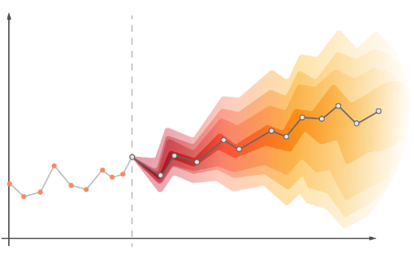
Goal
To create replicable lane-wise time series forecasting models that predict the amount of aggregate volume that RH will need to ship in coming years.

Slide 7
Business Benefits
A better lane-wise shipping volume prediction:
Allows RH to avoid the spot market at a higher rate; reducing total shipping costs
Can better guarantee that RH will be able to transport all of its goods
Will help to optimize how RH ships its volume
Avoid the financial penalties of over committing to a carrier
It will help to build long-term relationship between RH and the carrier companies.

Slide 8

Project Timeline
1 | 2 | 3 | 4 | 5 | 6 | 7 | 8 | 9
Weeks
Milestones
Kick-off | Data Exploration | Identifying Trends | Creating Key KPIs | Forecasting | Forecasting | Finalize Model | Establishing Results | Final Presentation
Tasks
Data Gathering and Understanding
Identifying Trends and Creating Key metrics & KPIs
Forecasting shipping lanes
Finalizing the Time Series model
Business Impact and Presentation

Slide 9
Data Dictionary
Data Columns​ | Data type​ | Description​ | Examples
Container num​ber | Character​ | Container number​ | ABCDE1234567
Shipment Id​ | Character​ | Shipment ID​ | 123456ABCDE1234
City​ of origin | Character​ | Shipping origin​ | Ho Chi Minh
POL city​ | Character​ | Port of loading​ | Hong Kong​
POD city​ | Character​ | Port of discharge​ | New York​
BL city​ | Character​ | Bill of lading city​ | Long Beach​
Type of Service | Character​ | Shipping service type​ | Container Yard - Door​
Name of carrier | Character​ | Shipping carriers​ | Evergreen​
Cargo Receipt date | Date​ | Cargo receipt date​ | 12/01/2020 09:00 PM PST​
Date departed | Date​ | Shipment departure date​ | 10/01/2021 08:00 PM PST​
Arrival date​ | Date​ | Shipment arrival date​ | 02/01/2020 19:00 PM PST​
Type of container | Character​ | Container type​ | 40'
Volume (in cubic meters)​ | Float​ | Shipping volume in CBM​ | 70.123
Lanes​ | Character​ | Shipping lanes (origin_pol_pod_bl)​ | Vung Tau_Vung Tau _Norfolk_North East
Dep_mon​ | Date​ | Departure year and month​ | 2020-06

Slide 10
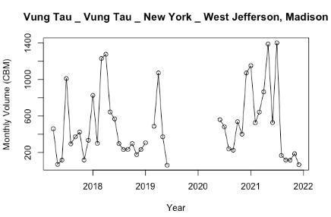
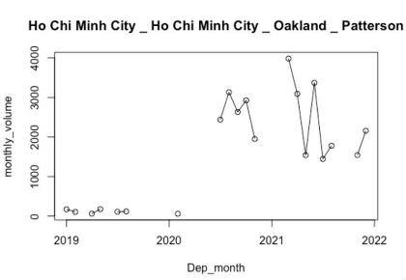
Data Challenges
Our Initial challenges with data:
The missing data percentage for the lanes that we modeled was anywhere from 5% to 59%.

Slide 11
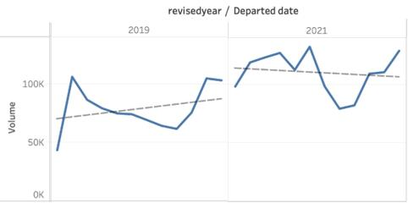
Data Challenges
Our Initial challenges with data:
Pre-covid and Post-covid data had drastic differences.
Selection of proper replacements for missing data.

Slide 12
Data Anomalies
Shipment that has volume below the minimal shipping threshold of 50 CBM
These data account for 16.10% of the total data.
More than half of lanes are no longer in use (assume lanes have no shipping data in 2019 and beyond are lanes no longer in operation)
These lanes account for 44.8% of the total number of lanes.

Slide 13
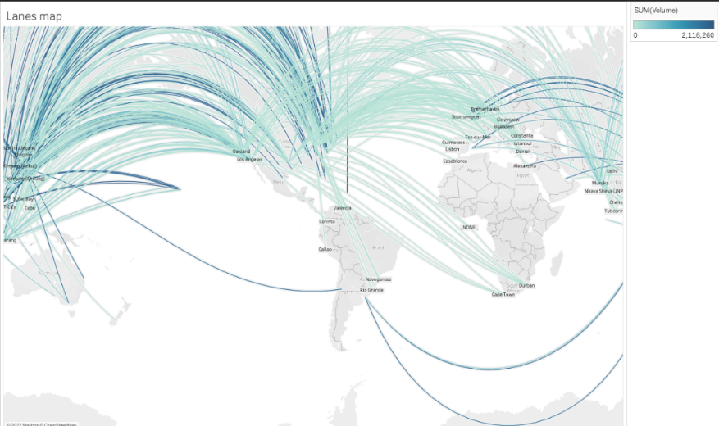
Exploratory Data Analysis
Darker lanes represent higher volumes(CBM)

Slide 14
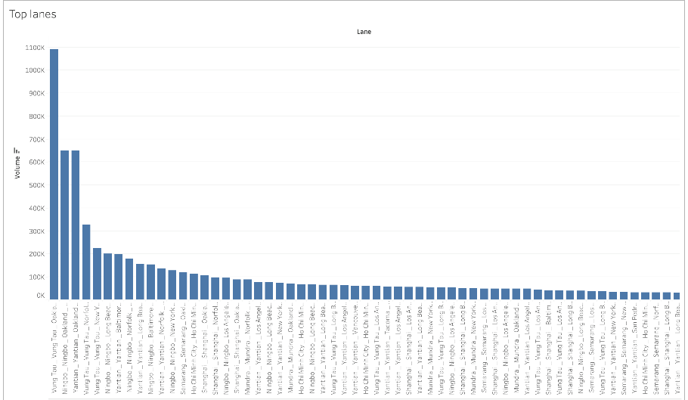
Exploratory Data Analysis

Slide 15
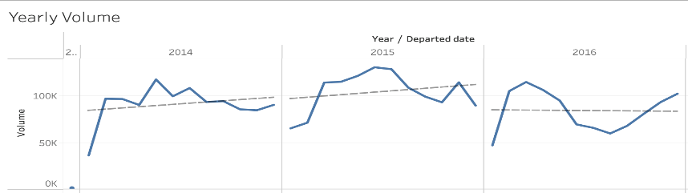
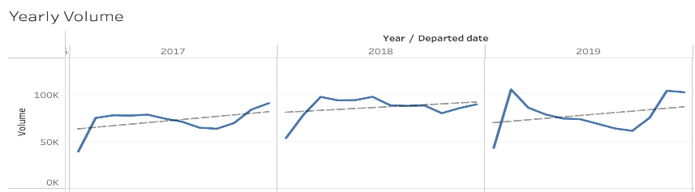
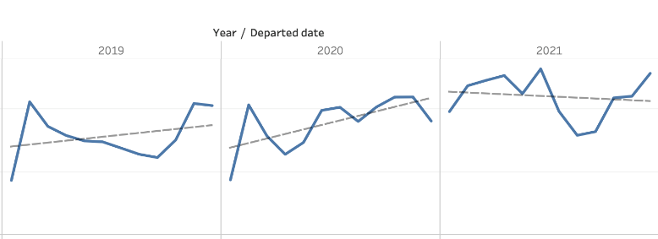
Historical Volume

Slide 16
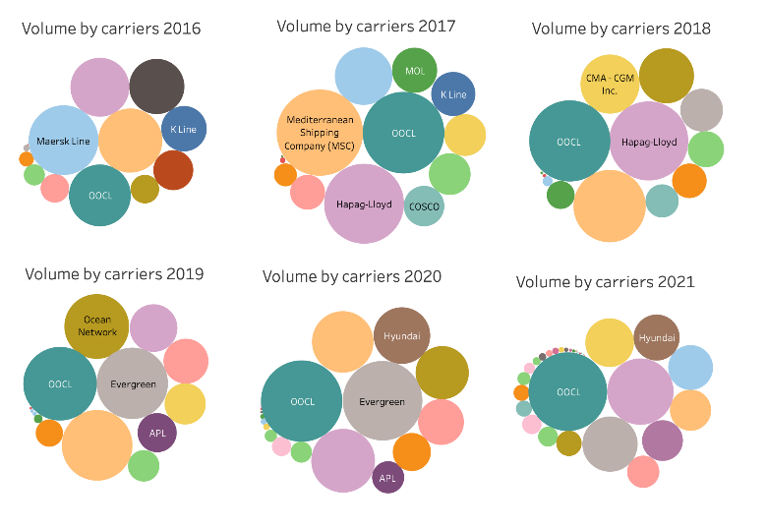
Carriers

Slide 17
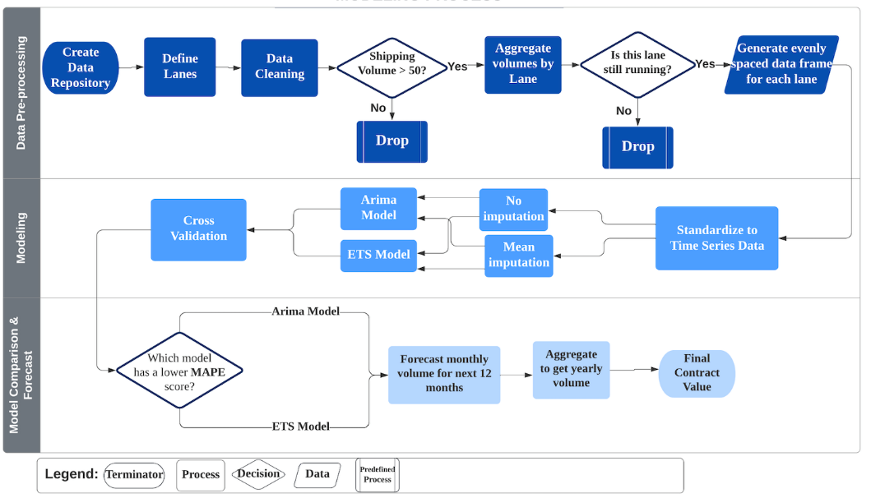
Modeling Process

Slide 18
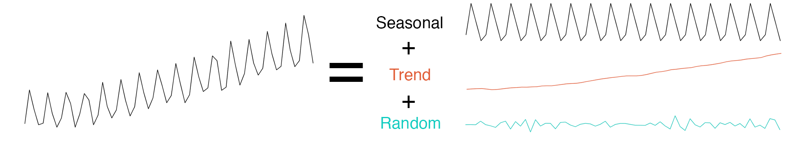
Key Concepts - Modeling
Error
ARIMA
Auto-Regressive Integrated Moving Average
Uses lagged moving average to predict the future value
ETS
Error – Trend – Seasonality
Uses weighted moving average to predict the future value

Slide 19
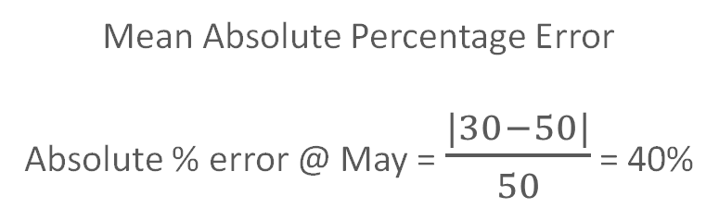
Key Concepts - Evaluation
MAPE
Mean Absolute Percentage Error
Absolute % error @ May = $\frac{|30−50|}{50}$ = 40%
Cross-Validation
Error aggregated over multiple training and testing sets
More efficient use of data to train the model

Slide 20
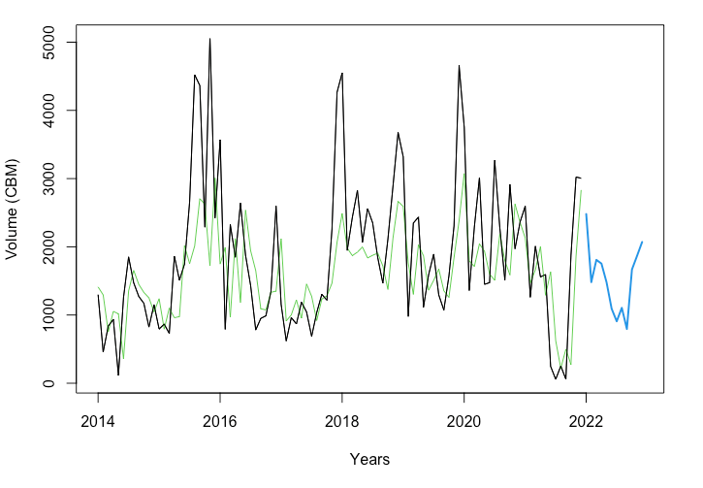
Result
A typical lane from Yantian to Baltimore with forecast for the next 12 months.

Slide 21
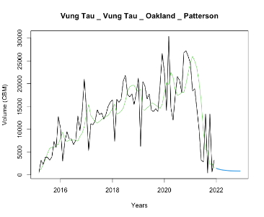
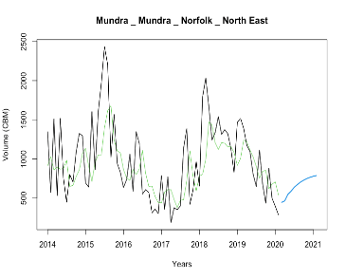
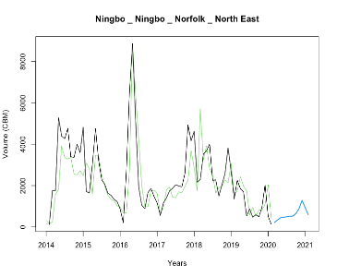
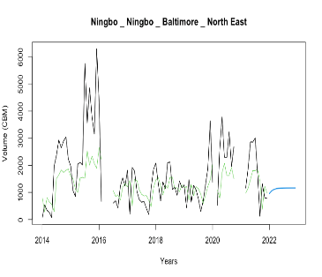
Result – Other Lanes
Vung Tao, Vietnam to Oakland, USA
Mundra, India to Norfolk, USA
Ningbo, China to Norfolk, USA
Ningbo, China to Baltimore, USA

Slide 22
Cost Savings
A more accurate forecast results in less volume going to the spot market.
Shipping on the spot market costs 2.56 times more than under contract.
Cost to Ship a 40 ft Container
Cost to Ship 1 CBM
Contract | Spot Market
$4,500 | $11,500
Contract | Spot Market
$75.15 | $192.04

Slide 23
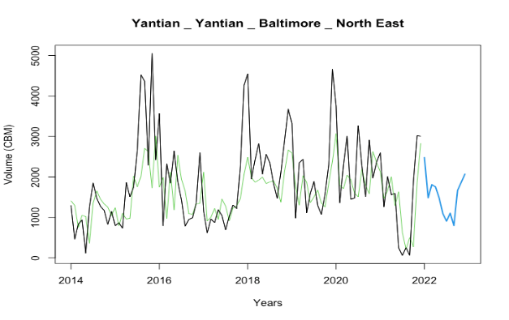
Predicting Future Demand
Current Prediction: RH sums the past 12 months of shipping volume to estimate future demand
New Model: Sums the 12-month future predicted values to get a value for future demand
Yantian, China to Baltimore, USA
Current Prediction
Model’s Prediction

Slide 24
Accuracy Comparison
Lane # | Lane (POL City to BL City) | RH's Error (CBM) | Our Model's Error (CBM) | Difference (CBM)
1 | Vung Tau, China to Patterson, CA (USA) | 46,602 | 6,431 | 40,170
2 | Ningbo, China Patterson, CA (USA) | 5,448 | 2,683 | 2,765
3 | Yantian, China to Patterson, CA (USA) | 3,536 | 15,338 | (11,802)
4 | Vung Tau, China to North East (USA) | 34,810 | 26,198 | 17,033
5 | Vung Tau, China to New York to North East (USA) | 14,093 | 5,426 | (12,104)
1-25 | All Lanes | 686,429 | 397,318 | 38,118
Our model reduces error by 17.7% or 38,118 CBM when predicting shipping volumes in 2023.

Slide 25
Business Impact
Roughly 7.5% of total volume is shipped on the spot market
66,000 total CBMs transported via spot for lanes 1-25
Using our model, we save 38,118 CBM from going to the spot market
For each CBM, there is a spread of $116.89 ($192.04 - $75.15)
Therefore, we can save RH roughly $4.46 million in shipping costs (38,118 CBM * $116.89) in 2023

Slide 26
Future Scope
Model Improvement
As more time passes since COVID, accuracy should increase
Each month that passes gives the model another recent datapoint to train on
Continued Analyses
RH can apply our model to a higher number of lanes
Test the accuracy of our forecasts over time and adjust accordingly
Insight across Business Units
Predictions can be leveraged to predict inventory, sales, etc.
Current Implementation
White-paper on how to run and update models
Web App (R Shiny)

Slide 27
Conclusion
Model application could save our client up to $4.46 million in 2023
An increase in forecast accuracy will help RH to build trust and relationships with their carriers
RH receives models that can be adjusted as business needs change
The Holt-Winters and ARIMA models can be effectively applied to time series data to solve real-world business problems
Thoughtful cross-validation design can drastically improve the accuracy of time series models

Slide 28
Questions?

Slide 29
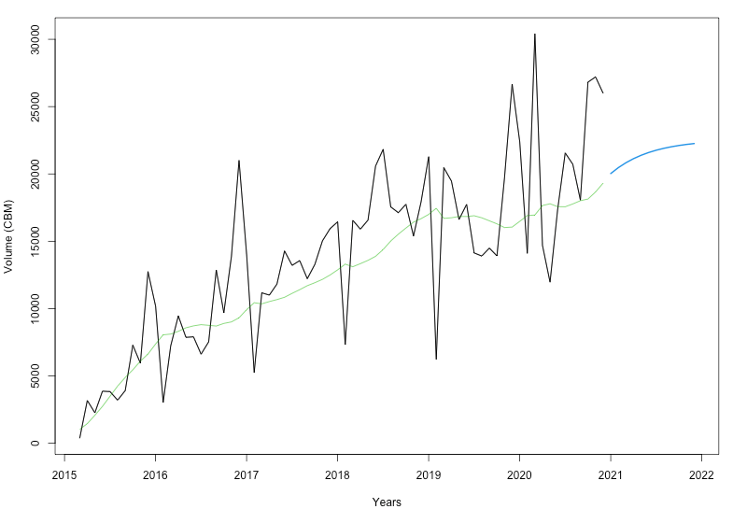
Lane: Vung Tao to Patterson

Slide 30
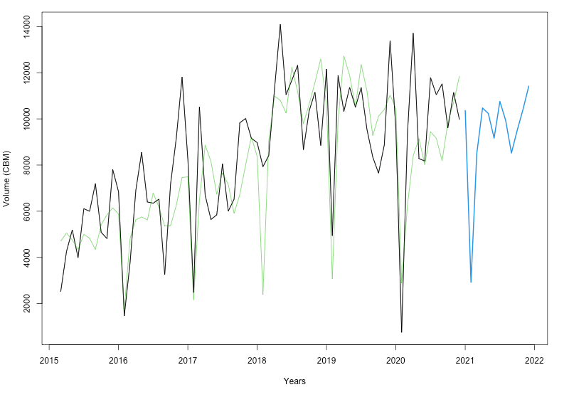
Lane: Ningbo to Patterson

Slide 31
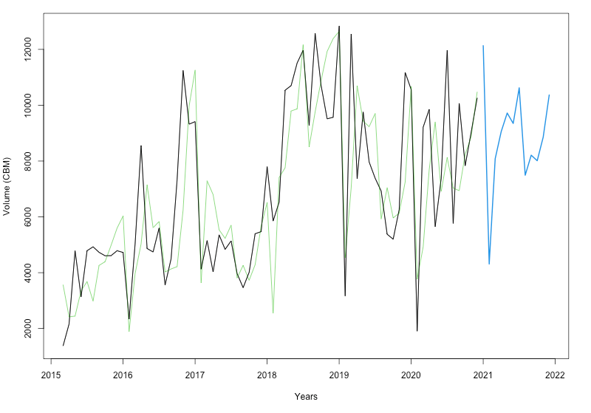
Lane: Yantian to Patterson

Slide 32
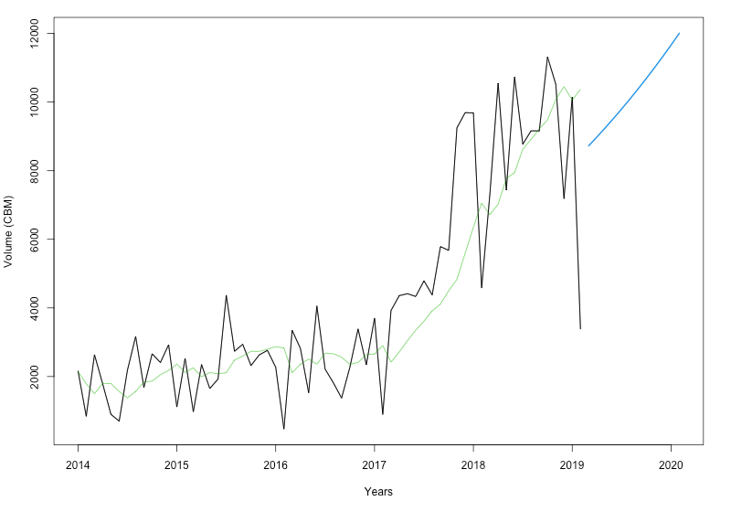
Lane: Vung Tao to Norfolk

Slide 33
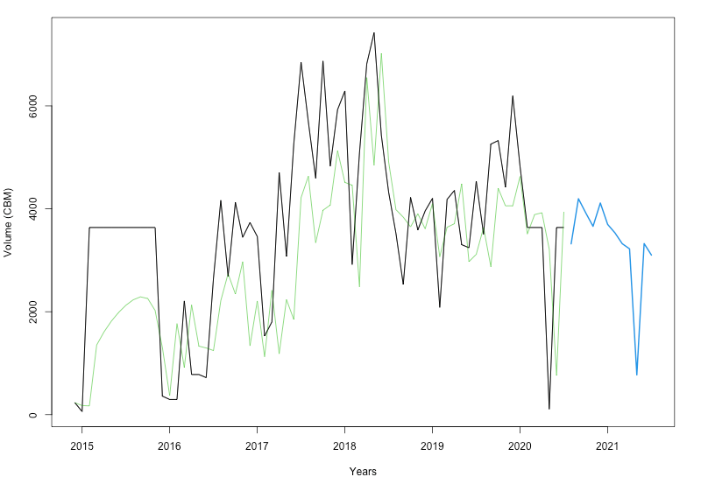
Lane: Ningbo to Long Beach

Slide 34
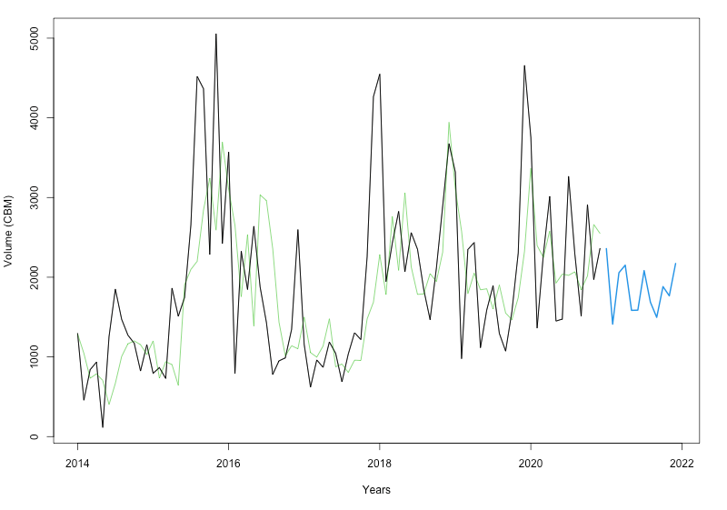
Lane: Yantian to Baltimore

Slide 35
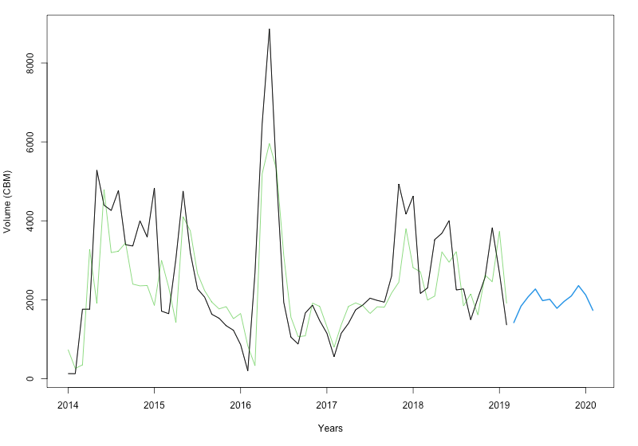
Lane: Ningbo to Norfolk

Slide 36
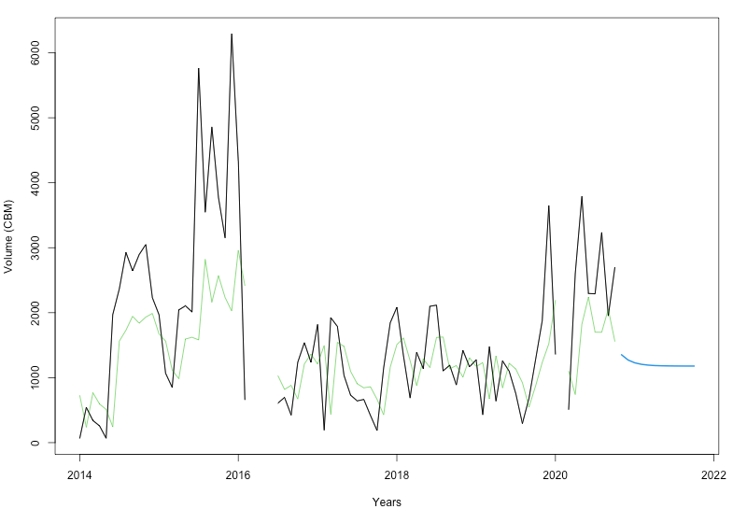
Lane: Ningbo to Baltimore

Slide 37
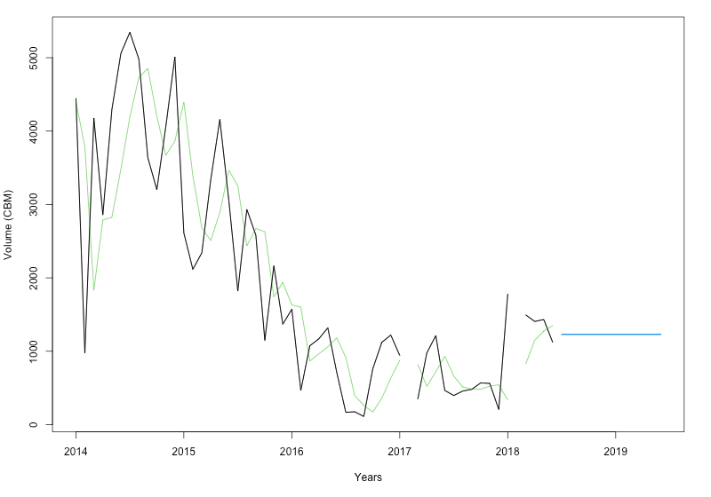
Lane: Yantian to Norfolk

Slide 38
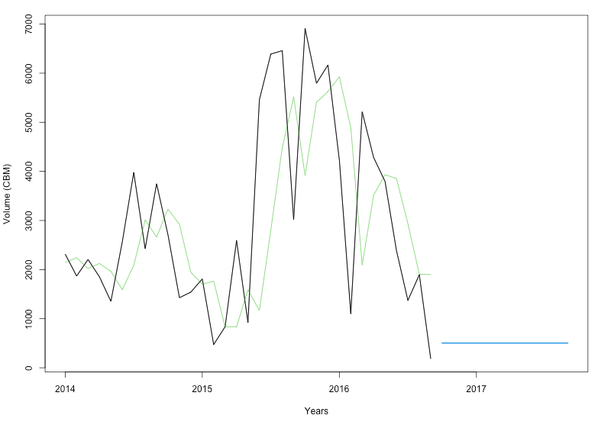
Lane: Ho Chi Minh to Baltimore

Slide 39
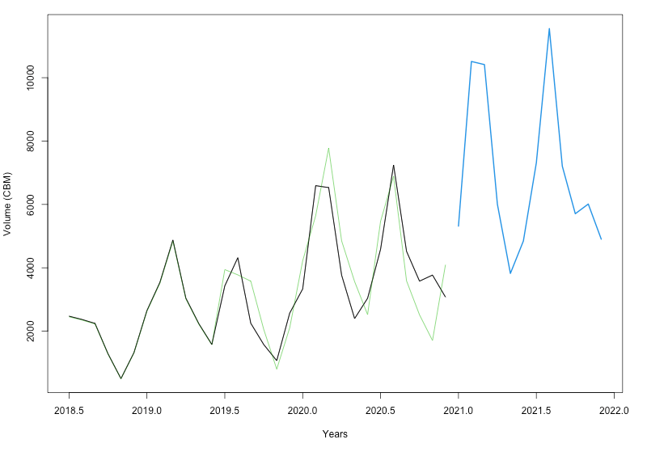
Lane: Semarang to Patterson

Slide 40
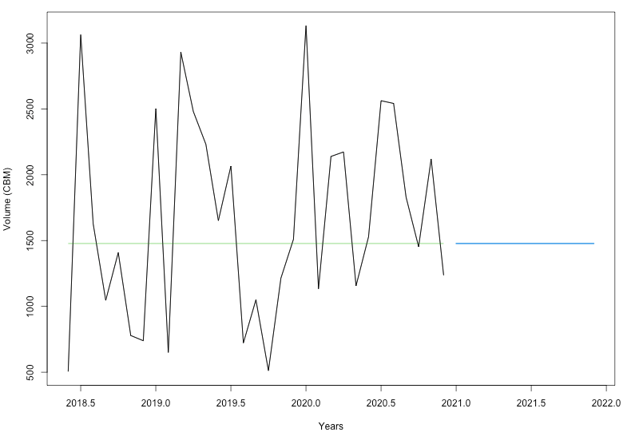
Lane: Shanghai to Patterson

Slide 41
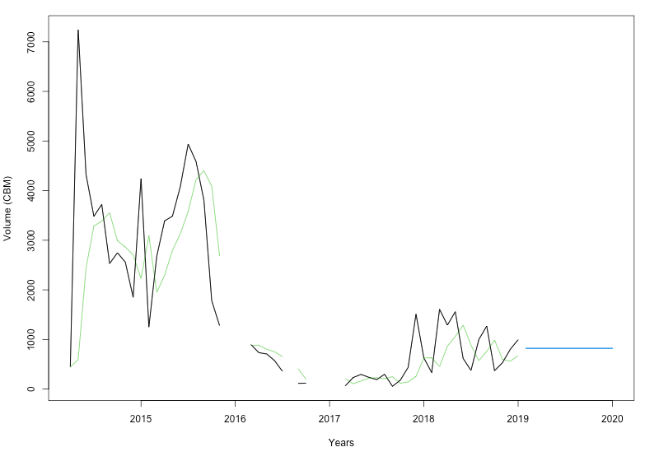
Lane: Shanghai to Norfolk

Slide 42
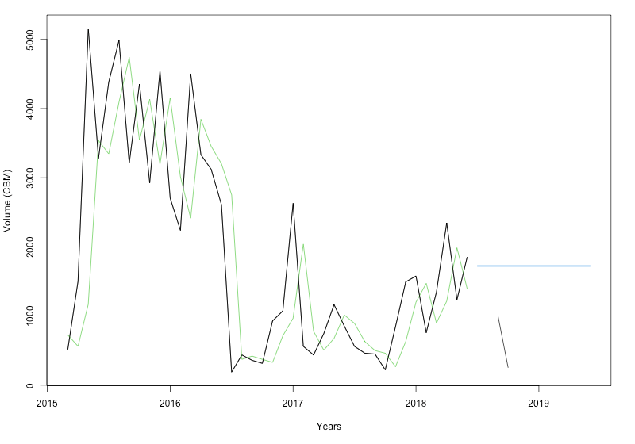
Lane: Shanghai to Oakland

Slide 43
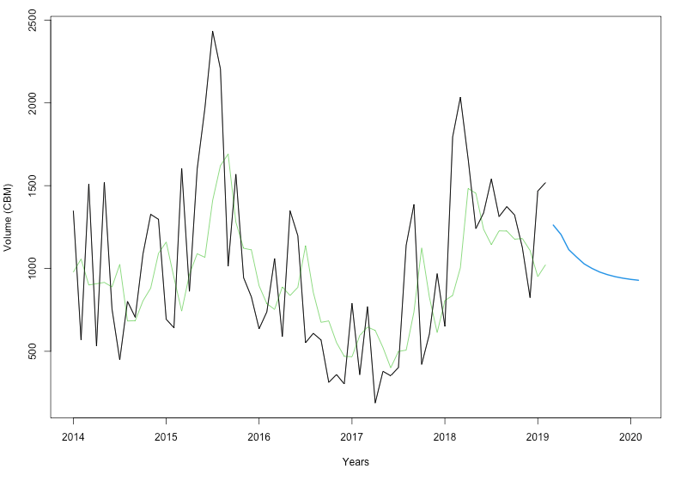
Lane: Mundra to Norfolk

Slide 44
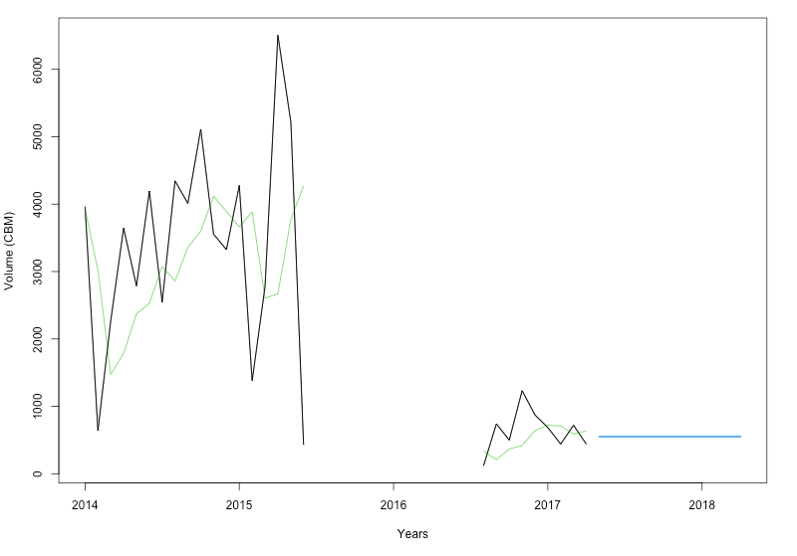
Lane: Ho Chi Minh to Norfolk

Slide 45
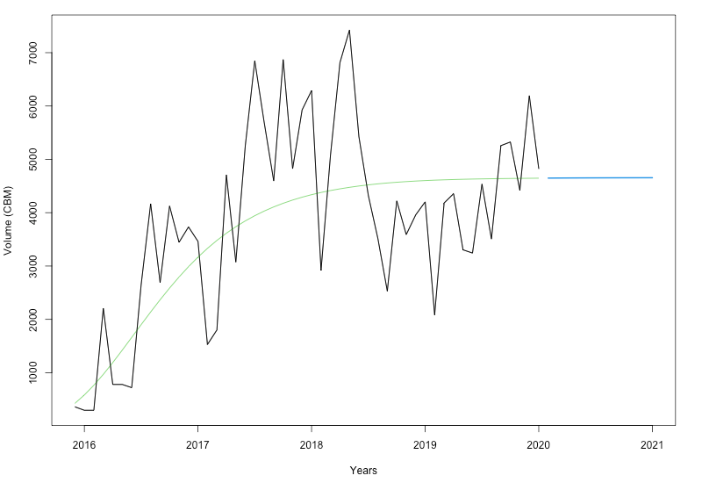
Lane: Yantian to Los Angeles

